Slide 1


PRIORITY SCHEDULING

Slide 2




Emergency Medical
Center
Prioritizing patient treatment using priority scheduling algorithm in medical emergencies.
Giving priority to patients with critical conditions such as respiratory distress or severe bleeding.
Objective nº 1
Objective nº 2
Objective nº 3

Slide 3
ALGORITHM:
1.START THE PROGRAM.
2.CREATE A PROCESS CLASS TO REPRESENT EACH CREATION WITH VARIABLES SUCH AS STYLE NUMBER, IDEA, AND EXECUTION TIME.
3.DEFINE THE PRIORITY_SCHEDULING FUNCTION FOR THE PRIORITY SCHEDULE PATTERN, WHERE OPERATIONS ARE EXECUTED ACCORDING TO THE FOLLOWING AND THEN THE WAITING TIME AND COMPLETION TIME ARE CALCULATED.
4.THIS IS DONE BY THE MAIN FUNCTION THAT ASKS THE USER FOR THE SIZE OF THE NUMBER OF OPERATIONS AND THEIR INFORMATION, AND THEN DOES THIS THROUGH A PRIORITY SYSTEM.
5.RUN THE EXECUTION OF THE PROGRAM THROUGH THE MAIN FUNCTION WHEN THE PROGRAM RUNS.
6.THESE STEPS ARE THE MAIN STEPS THAT THE SIMPLE PROGRAM PERFORMS PRIORITY SCHEDULING.
Objective nº 1
Objective nº 2
Objective nº 3

Slide 4

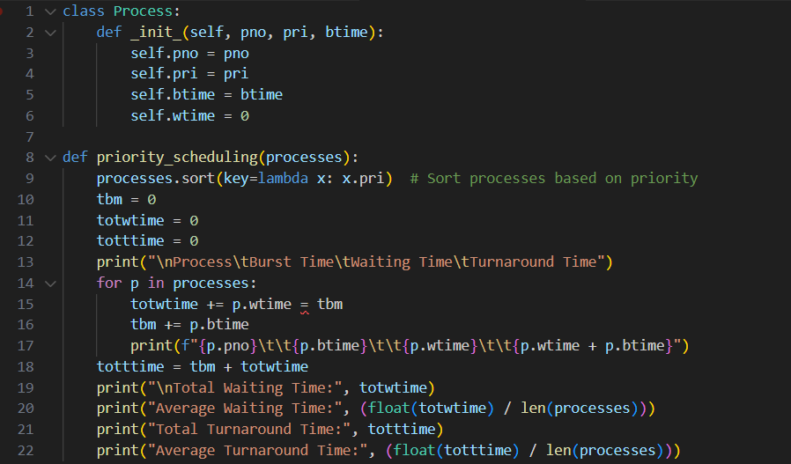

Slide 5
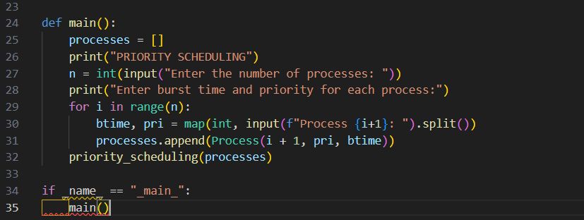

Slide 6


Thanks

